Slide 1
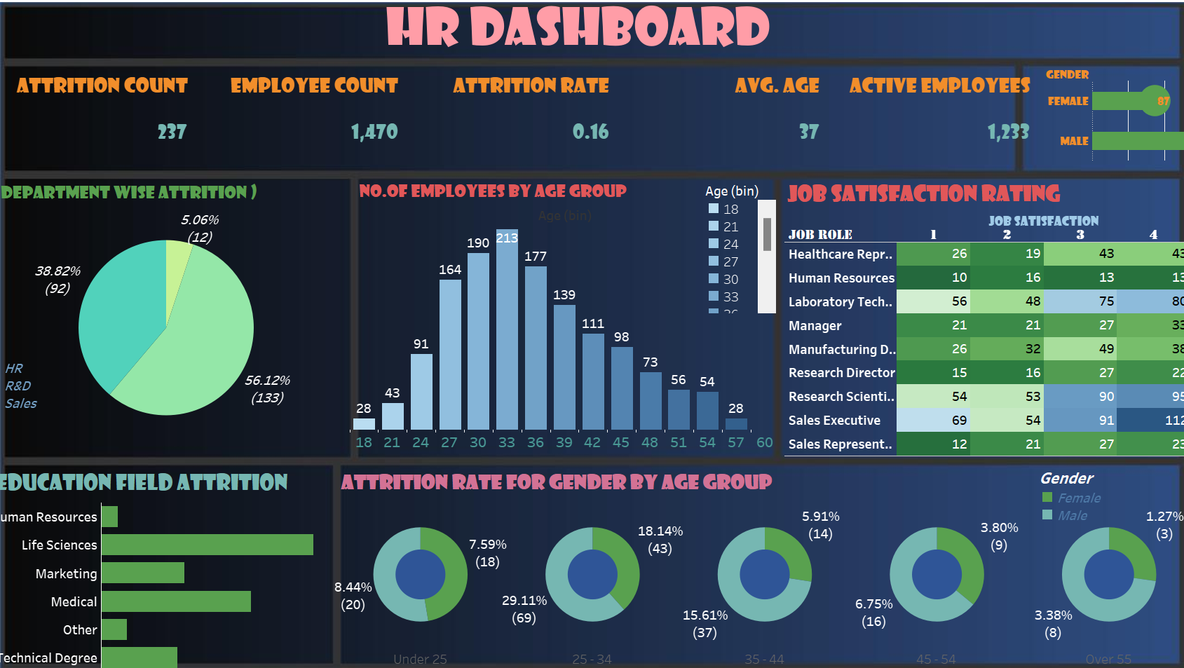
Visualizing Employee Attrition: Insights from Our HR Dashboard Using Tableau

Slide 2




Introduction to Employee Attrition
In this presentation, we will explore
through our HR
dashboard using . Understanding attrition is crucial for
and overall company health. We will analyze key metrics and visualize trends
that impact our workforce dynamics.

Slide 3
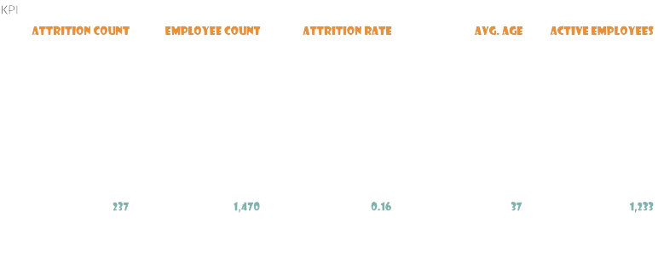


KPI S

Slide 4
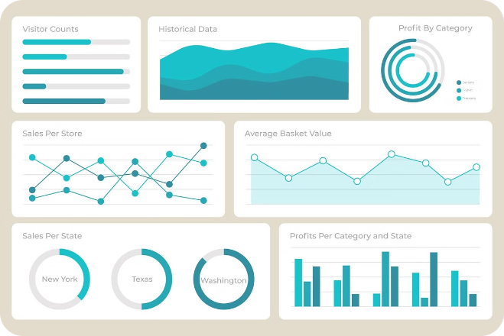
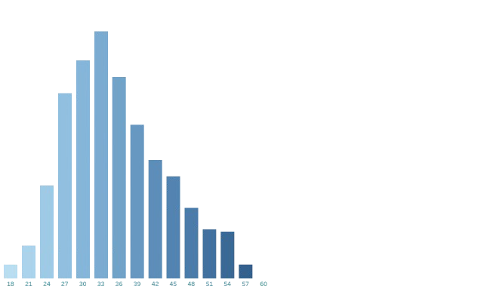
NUMBER OF EMPLOYEES BY AGE GROUP

Slide 5

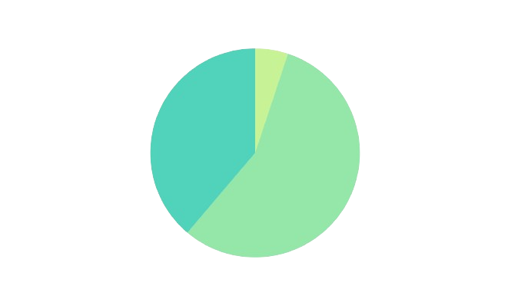
DEPARTMENT WISE ATTRITION

Slide 6

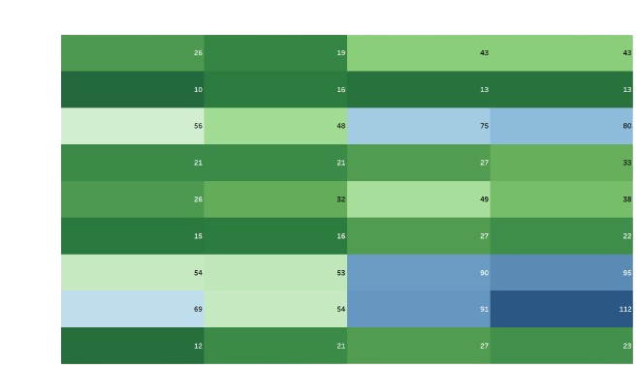
JOB SATISFACTION RATING

Slide 7

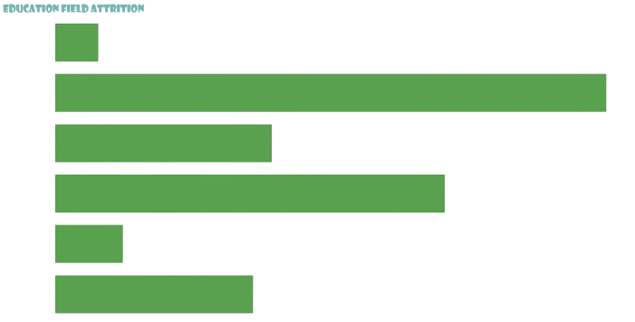
ATTRITION BY GENDER
ATTRITION BY GENDER

Slide 9



Conclusion
In conclusion, visualizing
through our HR dashboard has provided valuable insights.

Slide 10
Thanks!

